Slide 1

Introduction to Modern SCADA
Materials are from:
Book: Practical Modern SCADA Protocols: DNP3, 60870.5 and Related Systems by Gordon Clarke CP Eng

Slide 2
Supervisory Control and Data Acquisition
SCADA systems integrates Data Acquisition systems (Historians) with Data Transmission & HMI Software to provide a centralized monitoring and control system
Collect field information
Transfer to central computer facility
Operator monitoring or control from central location in near real time
Source: NIST special publication 800-82, Guide to ICS Security

Slide 3
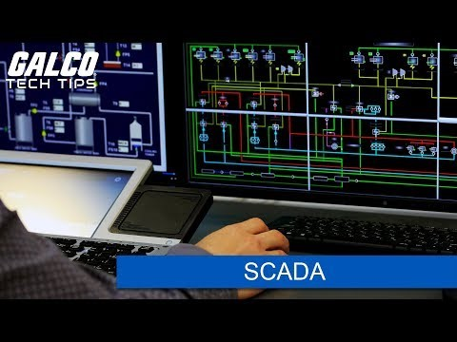
https://youtu.be/sphvkkybTt0

Slide 4
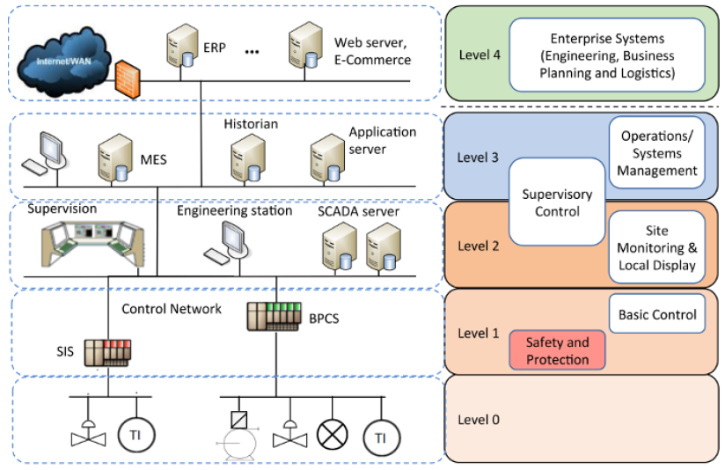
SCADA Main Components
HMI – Locally at field
RTU – Outdoor controller with networking capability
PLC – Industrial computer that receive signal, evaluates program and generates outputs to control process
Supervisory System – Software that gather data from controllers and provide central control
Data Historian – Acquire data from supervisory system
Data used by both industrial operation and enterprise
Recommended to be in Demilitarized zone
Communication infrastructure – Operation Technology and Information Technology

Slide 5
Data Historian
Also known as Operational Historian
Software application collecting real-time process data from automation processes
Concurrent or post data analysis
Time-stamped data
Usually a desktop workstation with standard operating system
Usually supports industrial protocols such as Modbus, Open Platform Communications (OPC) to directly connect to HMI / PLC/ RTU
Source: Cyber-security of SCADA and other Industrial Control Systems, Edward J.M.Colbert, Springer
Notes:
If you notice in the previous slides, data historian appear in SCADA, DCS, PLC network.

Slide 6
SCADA Software
Dynamic representation of process
Monitoring
Control
Alarm
Interface to Databases such as SQL, MS Access
Trending
Report
Proprietary – Developed to communicate with specific vendor hardware
Open – Interoperable with different manufacturers’ equipment on the same system
Open systems and communication standards
Open protocols
Variety of datalink technologies
Example of SCADA Drivers
http://advdownload.advantech.com/productfile/Downloadfile1/1-1QSZCG7/WebAccess%20V8.4%20Driver%20List.pdf

Slide 7
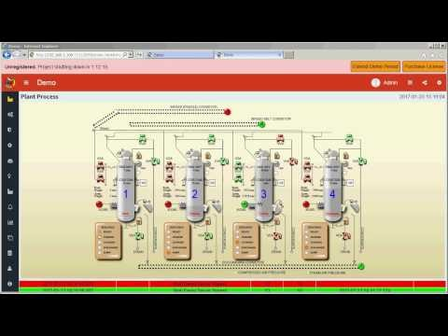
https://youtu.be/CMMK5B37Xx4

Slide 8

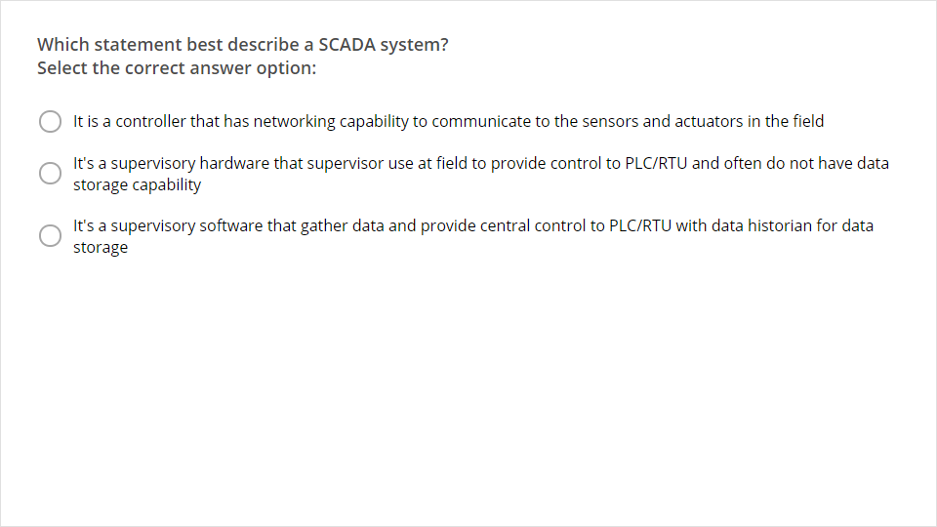
Quiz
Click the Quiz button to edit this object

